Slide 1
Time Series Analysis 2
SYS 4021/6021
Laura Barnes and Julianne Quinn

Slide 2
Organization of lecture
Review of Time Series Concept
Trigonometric Models of Seasonality
Autoregressive (AR) Models
Moving Average (MA) Models
Autoregressive Moving Average (ARMA) Models

Slide 3
Time Series Overview
A time series is a sequence of data that have been observed in successive order at discrete points in time.
It is commonly assumed time series data are spaced equally in time.
Time series often exhibit:
Trends
Cycles (repeated up and down movements)
Seasons (cycles with constant period)
Autocorrelation

Slide 4
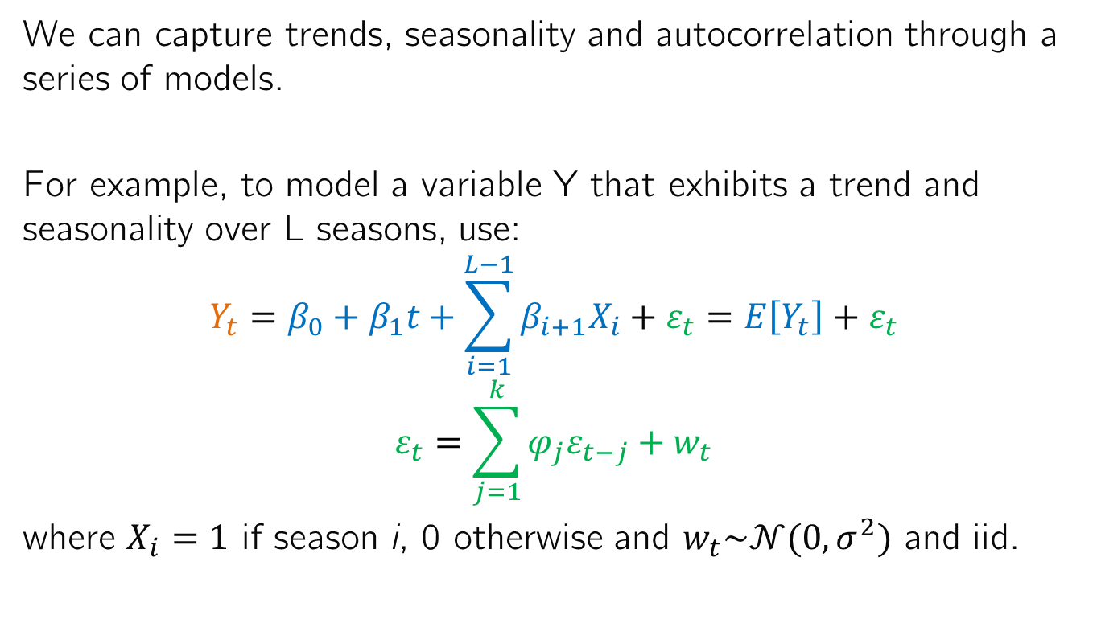
Simple Time Series Models
We can capture trends, seasonality and autocorrelation through a series of models.
For example, to model a variable Y that exhibits a trend and seasonality over L seasons, use:
$$Y_{t}=β_{0}+β_{1}t+\sum_{i=1}^{L−1}{β_{i+1}X_{i}}+ε_{t}=E\left[Y_{t}\right]+ε_{t}$$
$$ε_{t}=\sum_{j=1}^{k}{{φ_{j}ε}_{t−j}+w_{t}}$$
where $X_{i}=1$ if season i, 0 otherwise and $w_{t}\sim 𝒩(0,σ^{2})$ and iid.

Slide 5
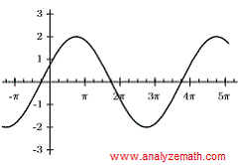

Modeling seasonality
Instead of using L-1 dummy variables to capture seasons, we noted this can also be captured with trigonometric functions.
Sometimes we will know the period (T) intuitively. But what about the phase shift (φ) and amplitude (A)? And what if there are multiple seasons in the dataset?
φ
T
A
$$Acos\left(\frac{2πt}{T}−φ\right)$$

Slide 6
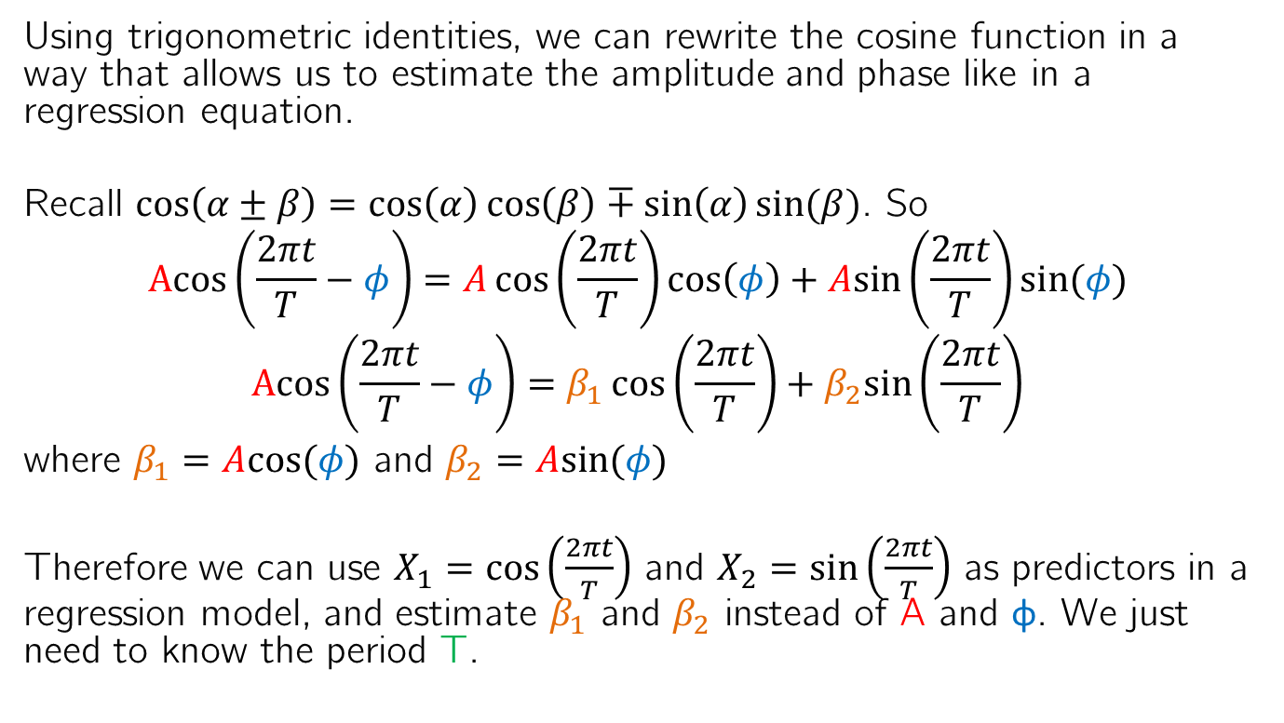
Modeling seasonality
Using trigonometric identities, we can rewrite the cosine function in a way that allows us to estimate the amplitude and phase like in a regression equation.
Recall $\cos\left(α±β\right)=\cos\left(α\right)\cos\left(β\right)∓\sin\left(α\right)sin⁡(β)$. So
$$Acos\left(\frac{2πt}{T}−φ\right)=A\cos\left(\frac{2πt}{T}\right)\cos\left(φ\right)+Asin⁡\left(\frac{2πt}{T}\right)sin⁡(φ)$$
$$Acos\left(\frac{2πt}{T}−φ\right)=β_{1}\cos\left(\frac{2πt}{T}\right)+β_{2}sin⁡\left(\frac{2πt}{T}\right)$$
where $β_{1}=Acos⁡(φ)$ and $β_{2}=Asin⁡(φ)$
Therefore we can use $X_{1}=cos⁡\left(\frac{2πt}{T}\right)$ and $X_{2}=sin⁡\left(\frac{2πt}{T}\right)$ as predictors in a regression model, and estimate $β_{1}$ and $β_{2}$ instead of A and φ. We just need to know the period T.

Slide 7
Period hunting
Sometimes the period T is intuitive, e.g. monthly temperatures should have a period of 12, corresponding to 1 year.
If there are multiple seasons, it may not be obvious. They may add up to create cycles of non-constant period (e.g. El Nino Southern Oscillations).
To find these periods we will consider spectral analysis.

Slide 8
Spectral Analysis
There are two branches of time series analysis:
Time domain: The present value is modeled with the past values (time series analysis)
Frequency domain: The present value is modeled with periodic sines and cosines (spectral analysis)
Spectral analysis acknowledges that any time series can be represented as a sum of sinusoids with different amplitudes, A, oscillating at different frequencies, f.
The frequency is the inverse of the period, i.e. T = 1/f.

Slide 9
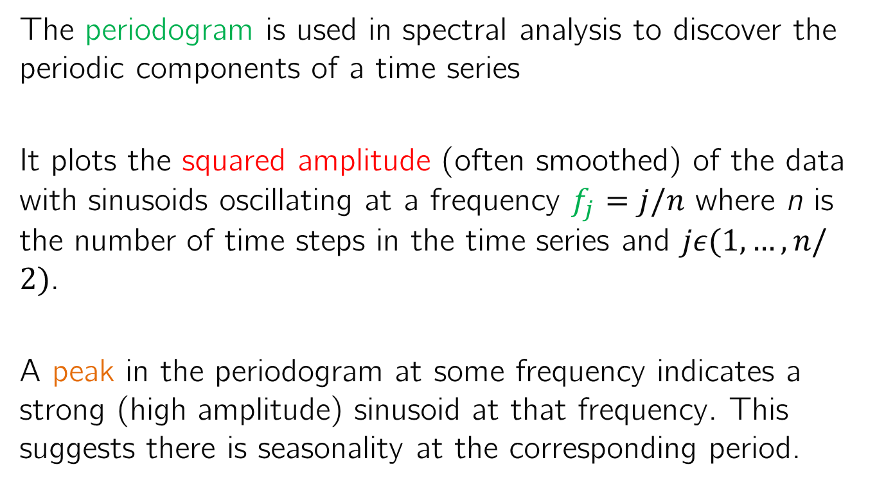
Periodogram
The periodogram is used in spectral analysis to discover the periodic components of a time series
It plots the squared amplitude (often smoothed) of the data with sinusoids oscillating at a frequency $f_{j}=j/n$ where n is the number of time steps in the time series and $jε(1,…,n/2)$.
A peak in the periodogram at some frequency indicates a strong (high amplitude) sinusoid at that frequency. This suggests there is seasonality at the corresponding period.

Slide 10
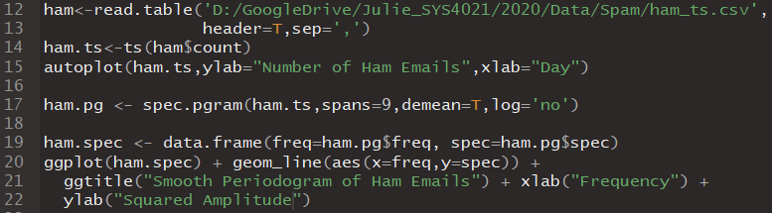
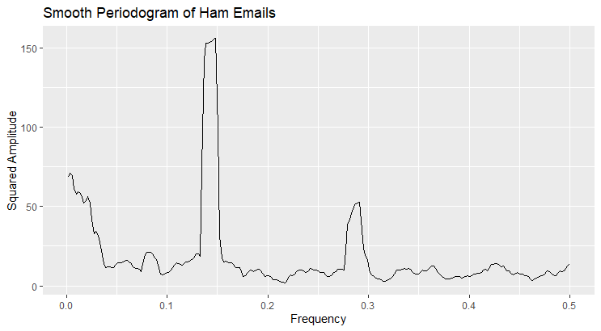
Example Periodogram
There are a few notable peaks.
1
3
2

Slide 11
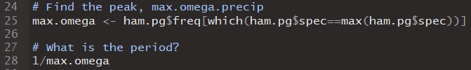

Example Periodogram
This corresponds to ~ 7 days, the expected weekly season.
There are a few notable peaks.
1

Slide 12
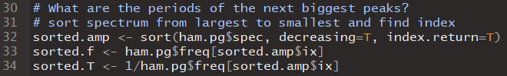

Example Periodogram
There are a few notable peaks.
This corresponds to ~ 3.5 days, half the expected weekly season.
2

Slide 13
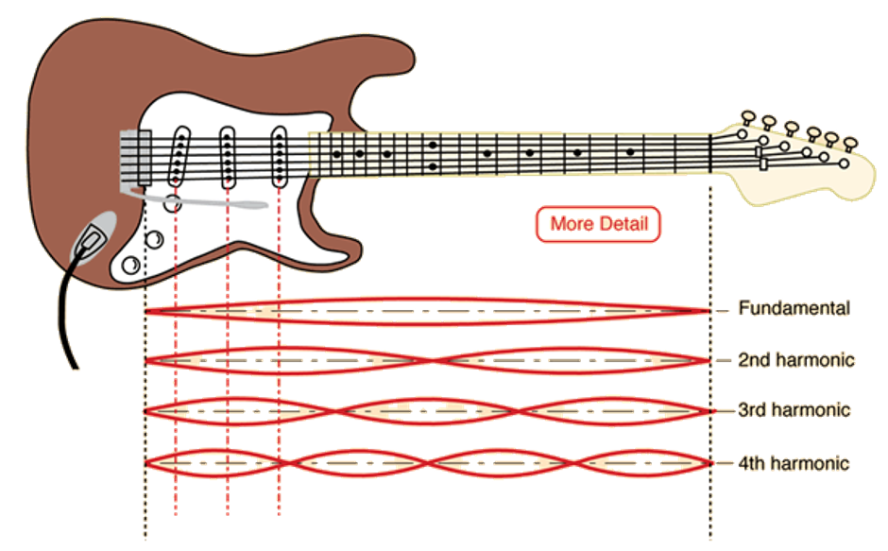
Harmonics
We will often get modulated peaks at harmonics like this. Their weighted sum (different amplitudes and phases) allows for asymmetric seasons (e.g. rise faster than fall)

Slide 14
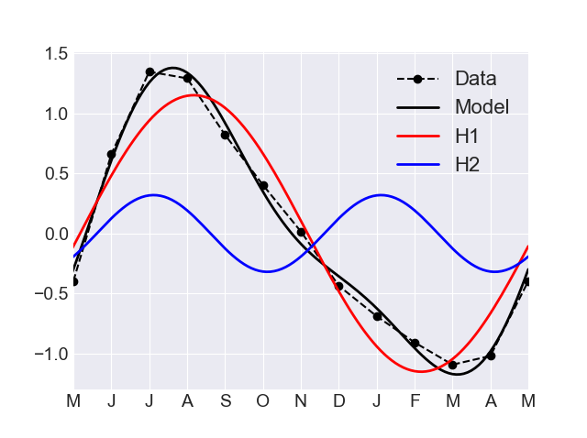
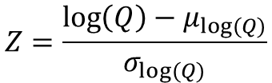
Example of harmonics in hydrologic data
$$Z=\frac{\log\left(Q\right)−μ_{log⁡(Q)}}{σ_{log⁡(Q)}}$$
Q = Flow

Slide 15
Example Periodogram
There are a few notable peaks.
These correspond to the low frequencies or high periods. Data with high autocorrelation will exhibit greater variability on these longer time horizons.
3

Slide 16
Example Periodogram
There are a few notable peaks.
This is called red noise, as like the red spectrum of visible light, it has the greatest amplitude at the lowest frequencies/highest wavelengths.
3

Slide 17
Example Periodogram
There are a few notable peaks.
We won’t typically model this through seasons, but through autoregressive models.
3

Slide 18
Example Periodogram
There are a few notable peaks.
After modeling all of these peaks, the residuals should have about equal amplitudes at all frequencies. This is called “white noise” since white reflects all wavelengths/frequencies of visible light.
3

Slide 19
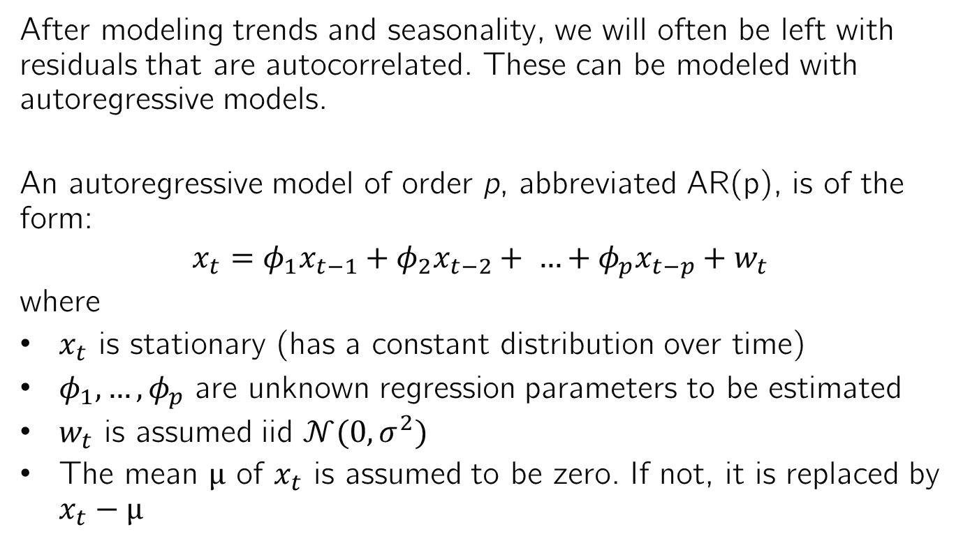
Autoregressive Models
After modeling trends and seasonality, we will often be left with residuals that are autocorrelated. These can be modeled with autoregressive models.
An autoregressive model of order p, abbreviated AR(p), is of the form:
$$x_{t}=φ_{1}x_{t−1}+φ_{2}x_{t−2}+ …+φ_{p}x_{t−p}+w_{t}$$
where
$x_{t}$ is stationary (has a constant distribution over time)
$φ_{1},…,φ_{p}$ are unknown regression parameters to be estimated
$w_{t}$ is assumed iid $𝒩(0,σ^{2})$
The mean μ of $x_{t}$ is assumed to be zero. If not, it is replaced by $x_{t}−μ$

Slide 20
Stationarity
We define a weakly stationary time series as one with:
Constant mean
Autocorrelation is a function of the lag
We can detect nonstationary time series by looking at the time series plot or the autocorrelation function.
A time series with a trend is nonstationary
An ACF with slow or linear decay is nonstationary

Slide 21
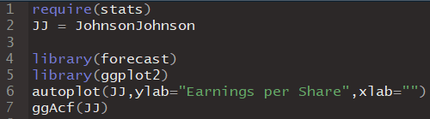
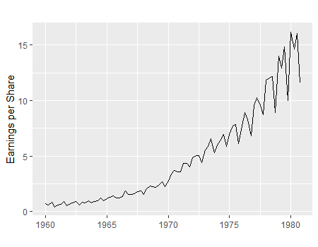
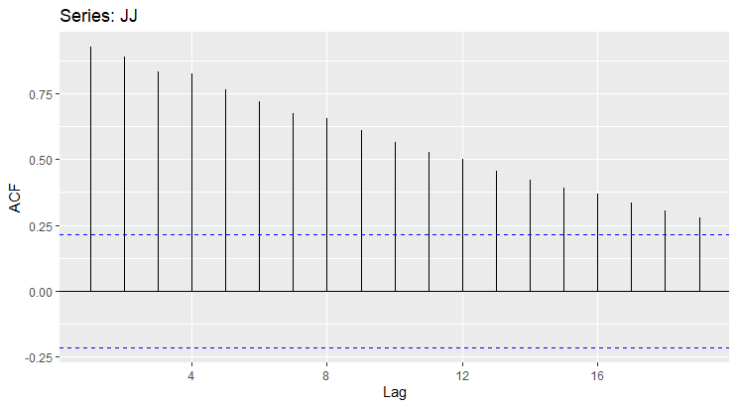
Example Non-Stationary Time Series

Slide 22
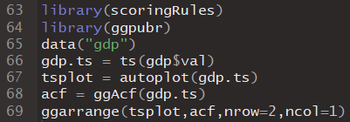
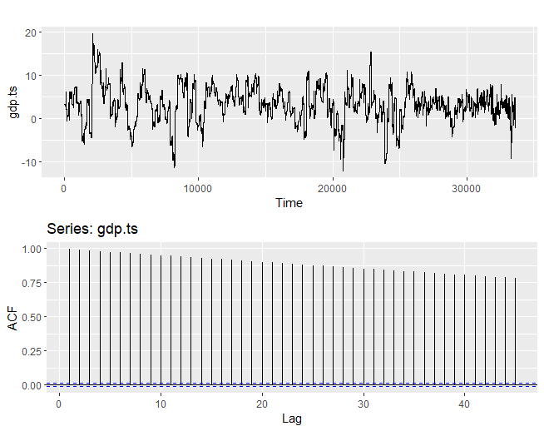
Example Non-Stationary Time Series

Slide 23
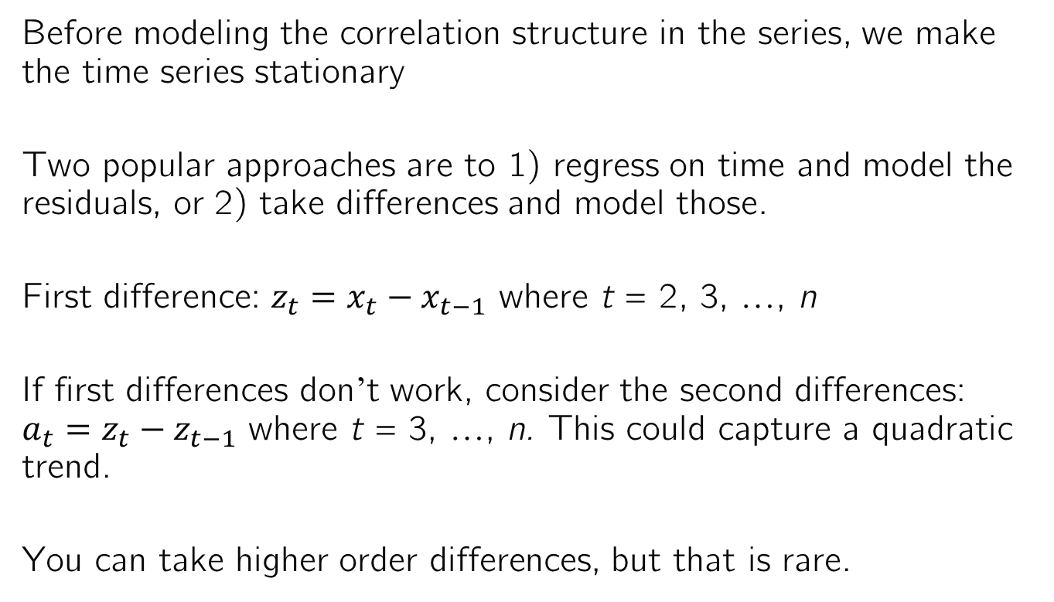
Stationary Time Series
Before modeling the correlation structure in the series, we make the time series stationary
Two popular approaches are to 1) regress on time and model the residuals, or 2) take differences and model those.
First difference: $z_{t}=x_{t}−x_{t−1}$ where t = 2, 3, …, n
If first differences don’t work, consider the second differences: $a_{t}=z_{t}−z_{t−1}$ where t = 3, …, n. This could capture a quadratic trend.
You can take higher order differences, but that is rare.

Slide 24
Autoregressive Models
After modeling trends and seasonality, we will often be left with residuals that are autocorrelated. These can be modeled with autoregressive models.
An autoregressive model of order p, abbreviated AR(p), is of the form:
$$x_{t}=φ_{1}x_{t−1}+φ_{2}x_{t−2}+ …+φ_{p}x_{t−p}+w_{t}$$
where
$x_{t}$ is stationary (has a constant distribution over time)
$φ_{1},…,φ_{p}$ are unknown regression parameters to be estimated
$w_{t}$ is assumed iid $𝒩(0,σ^{2})$
The mean μ of $x_{t}$ is assumed to be zero. If not, it is replaced by $x_{t}−μ$

Slide 25
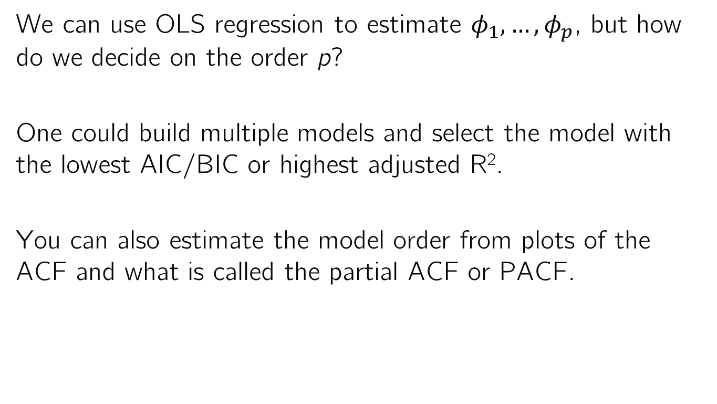
The Order of Autoregressive Models
We can use OLS regression to estimate $φ_{1},…,φ_{p}$, but how do we decide on the order p?
One could build multiple models and select the model with the lowest AIC/BIC or highest adjusted R².
You can also estimate the model order from plots of the ACF and what is called the partial ACF or PACF.

Slide 26
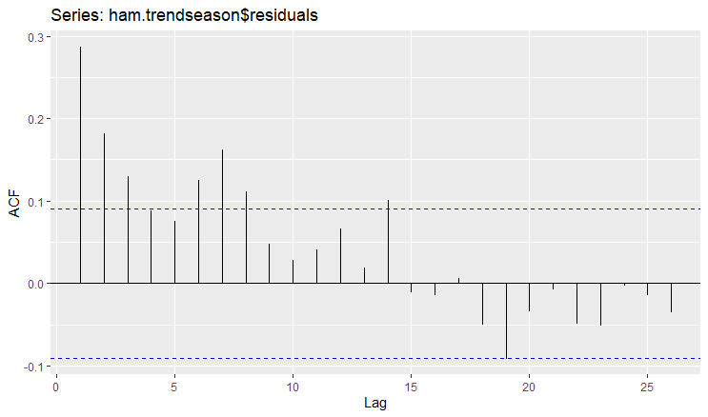

Autocorrelation
Recall the ACF shows Corr(Y_{t}, Y_{t-k}) at different lags k.
Any observation outside $±\frac{2}{\sqrt{n}}$ of 0 is statistically significant.
All of these are significant. Do we need all of them in our autoregressive model?

Slide 27
Partial Autocorrelation
If Corr(Y_{t}, Y_{t-1}) is high, so too will Corr(Y_{t-1}, Y_{t-2}) be high.
Therefore Corr(Y_{t}, Y_{t-2}) will likely be high as well.
If we put but Y_{t-2} and Y_{t-1} in our model, we might have problems with multicollinearity.
We only want to add Y_{t-2} in addition to Y_{t-1} if it adds predictive value while controlling for Y_{t-1}.
The partial autocorrelation assesses this value.

Slide 28
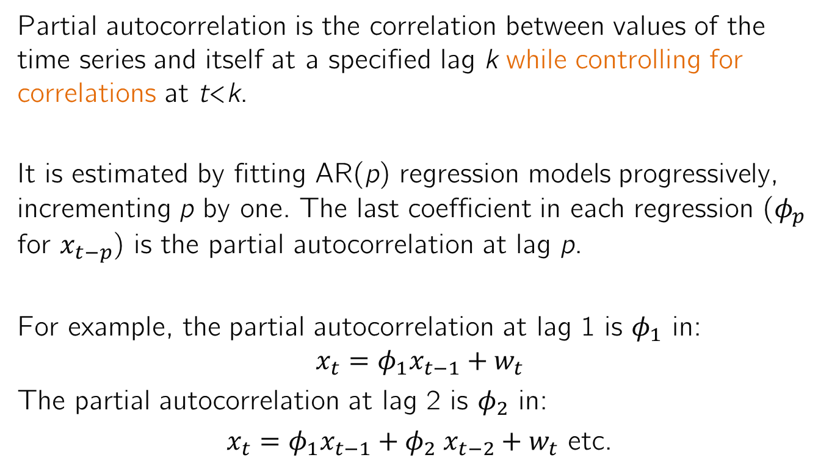
Partial Autocorrelation Function
Partial autocorrelation is the correlation between values of the time series and itself at a specified lag k while controlling for correlations at t<k.
It is estimated by fitting AR(p) regression models progressively, incrementing p by one. The last coefficient in each regression ($φ_{p}$ for $x_{t−p}$) is the partial autocorrelation at lag p.
For example, the partial autocorrelation at lag 1 is $φ_{1}$ in:
$$x_{t}=φ_{1}x_{t−1}+w_{t}$$
The partial autocorrelation at lag 2 is $φ_{2}$ in:
$x_{t}=φ_{1}x_{t−1}{+ φ}_{2}x_{t−2}+w_{t}$ etc.

Slide 29
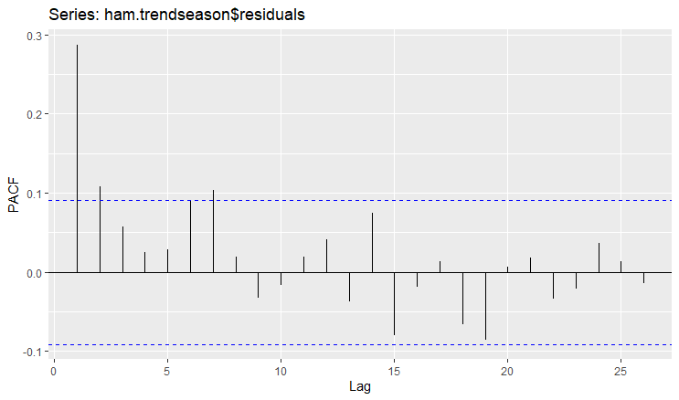
Partial Autocorrelation Function
Only three lags are significant in the PACF: lags 1, 2 and 7.
We may not need lag 7.

Slide 30
Choosing the order of AR models
For AR(p) models the PACF cuts-off, or becomes insignificant, after p lags.
For AR(p) models the ACF shows sinusoidal or exponential decay (tails off).
For nonstationary processes the ACF shows linear decay.

Slide 31
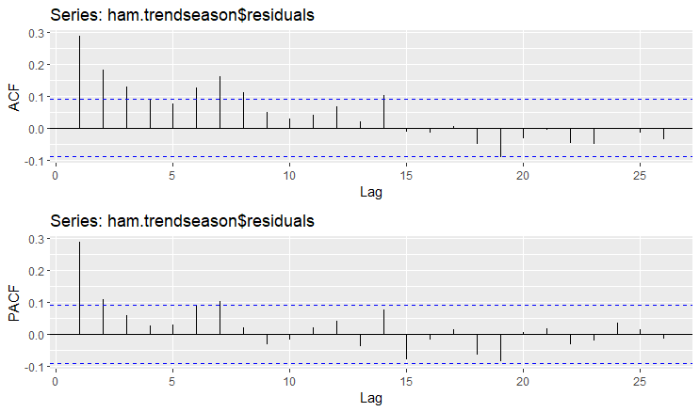
What order would you choose for these residuals?
Sinusoidal decay of ACF
PACF cuts off after 2 lags (often ignore subsequent lags that become significant)
Try AR(2) model. But what if the ACF and PACF don’t follow this pattern?

Slide 32
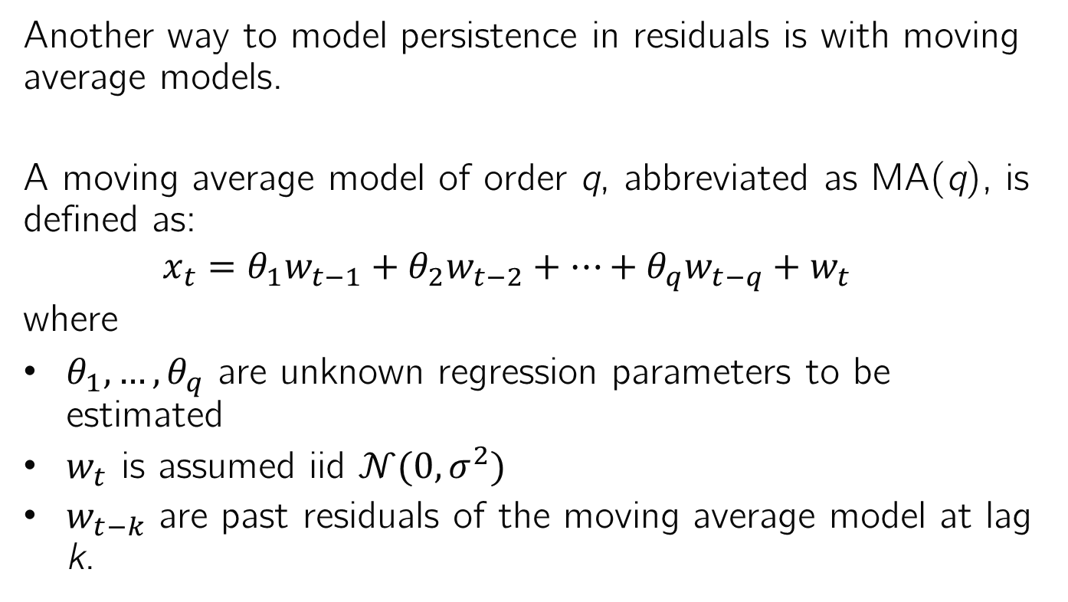
Moving Average Models
Another way to model persistence in residuals is with moving average models.
A moving average model of order q, abbreviated as MA(q), is defined as:
$$x_{t}=θ_{1}w_{t−1}+θ_{2}w_{t−2}+…+θ_{q}w_{t−q}+w_{t}$$
where
$θ_{1},…,θ_{q}$ are unknown regression parameters to be estimated
$w_{t}$ is assumed iid $𝒩(0,σ^{2})$
$w_{t−k}$ are past residuals of the moving average model at lag k.

Slide 33
ACF and PACF of MA Models
Because MA models must estimate coefficients on past residuals, which depend on the model fit, they have to be estimated iteratively through maximum likelihood estimation.
MA models are not as easily interpreted as AR models, but they are useful for modeling many real-world time series.
The order q of MA models can be determined according to the opposite pattern of AR models:
The ACF cuts off or becomes insignificant after q lags.
The PACF shows sinusoidal or exponential decay (tails off)

Slide 34
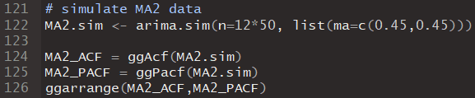
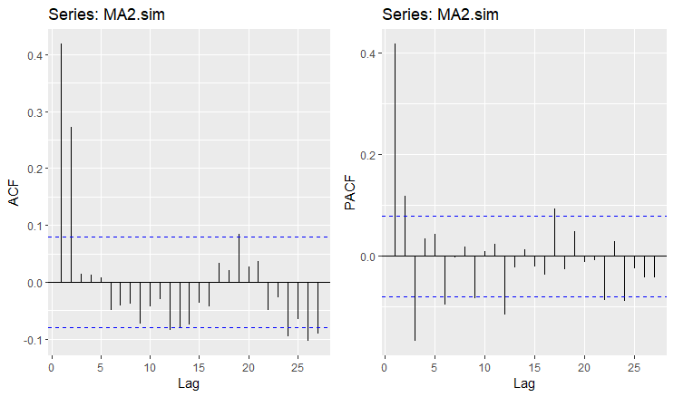
Example Moving Average Time Series
ACF cuts off after 2 lags (often ignore subsequent lags that become significant)
Sinusoidal decay of PACF
Try MA(2) model. But what if the ACF and PACF don’t follow this pattern either?

Slide 35
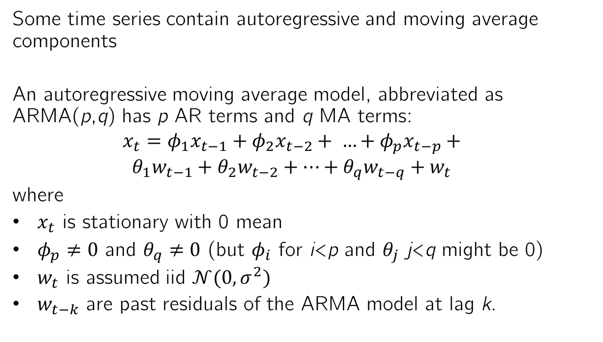
Autoregressive Moving Average Models
Some time series contain autoregressive and moving average components
An autoregressive moving average model, abbreviated as ARMA(p,q) has p AR terms and q MA terms:
$$x_{t}=φ_{1}x_{t−1}+φ_{2}x_{t−2}+ …+φ_{p}x_{t−p}+$$
$$θ_{1}w_{t−1}+θ_{2}w_{t−2}+…+θ_{q}w_{t−q}+w_{t}$$
where
$x_{t}$ is stationary with 0 mean
$φ_{p}≠0$ and $θ_{q}≠0$ (but $φ_{i}$ for i<p and $θ_{j}$ j<q might be 0)
$w_{t}$ is assumed iid $𝒩(0,σ^{2})$
$w_{t−k}$ are past residuals of the ARMA model at lag k.

Slide 36
Estimating ARMA models
Like MA models, the coefficients of ARMA models must be estimated through maximum likelihood estimation.
Since both AR and MA components are embedded in the time series, both the ACF and PACF tail off in a sinusoidal pattern or exponentially decay.

Slide 37
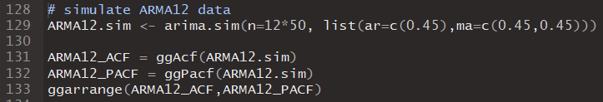
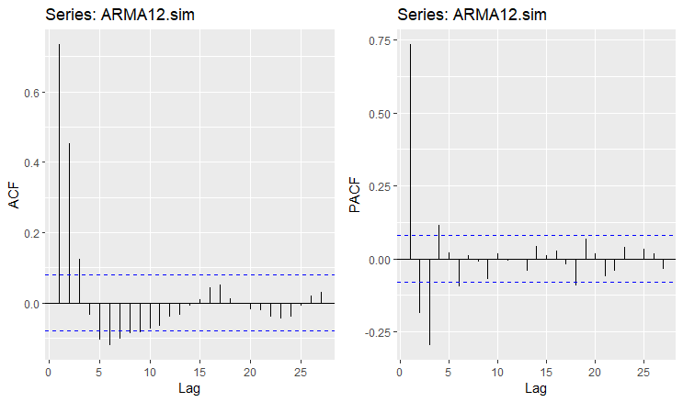
Example ARMA Time Series
Both the ACF and PACF decay sinusoidally

Slide 38
Summary
To see if there are seasonal components in a time series, and to estimate their periods, one can use the periodogram.
Peaks in the periodogram at low frequencies can be a sign of autocorrelation, not seasonality.
Autocorrelation can be modeled through autoregressive (AR), moving average (MA), and autoregressive moving average (ARMA) models.
The ACF and PACF can help identify the orders of these models. When unclear, metrics like AIC can be used.

